Slide 1






Twitter Pluviometer
Student: Vitor Yuichi Hossaki
Supervisor: Prof. Dr. Leonardo Bacelar Lima Santos
Collaborator: Prof. Dr. Rogério Galante Negri

Slide 2








Overview
Clouds
Rainfall impacts
Hydrological Impacts
02
03
Blocked Road
Data Base
Data processing
04
05
06
3.
1.
2.
Cloud formation and precipitation
Rain affects the city and basins
The rain causes hydrological impacts
4.
5.
6.
Roads blocked due to accumulation of water on site
Recording the starting and ending time of the blocks
Data collection, processing and analysis

Slide 3











Materials and methods
Motivation
New solutions to early warnings for flooding;
The increasing incidence of flooding due to climate change;
Tweets
Data processing
with Python
CSV files with processed data
Flood Data Base
Literature
Determining flooded areas using crowd sensing data and weather radar precipitation: a case study in Brazil. HORITA, Flávio; BRESSIANI, Danielle; PALMA, Gilca; ALBUQUERQUE, João.P. 2018
Statistics
Plots

Slide 4
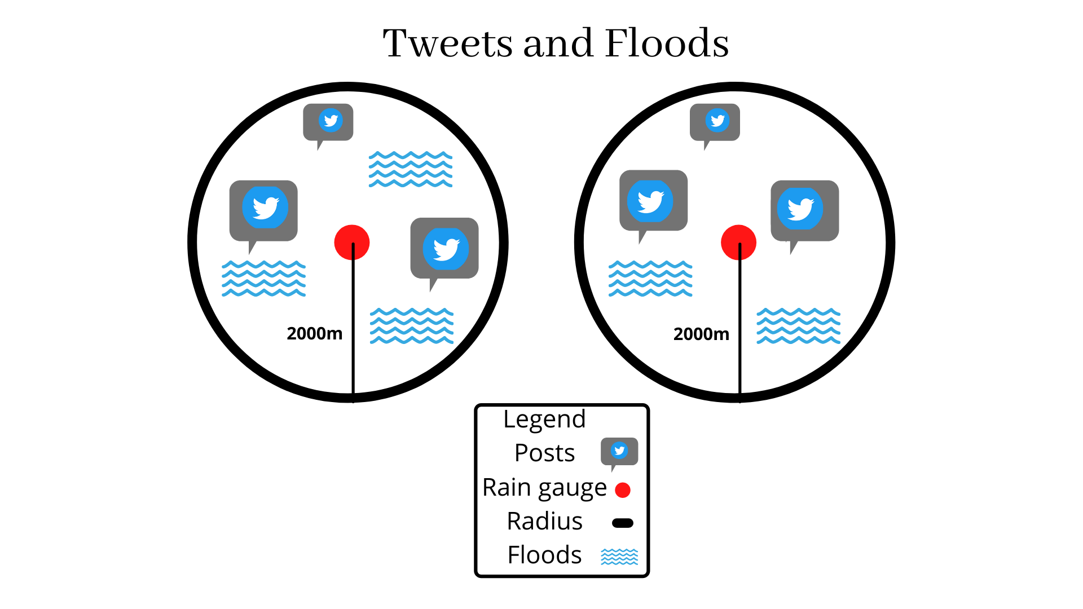
Materials and methods
Time: 16h to 20h
Temporal Window: 01/01/2019 to 30/03/2019
Author (2021)

Slide 5
This work
Research Topic: Twitter rain gauge, analyze the relation between rainfall data and tweets for flood forecasting
Objective: Process and analyze rainfall and twitter data to predict floods
Scientific hypothesis: There is a statistical relation between crowdsensing and rainfall data to structure a way to detect floods

Slide 6
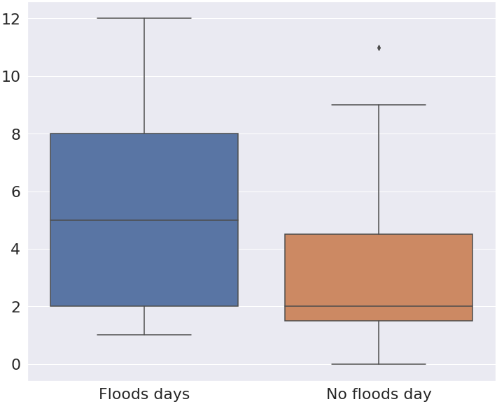
Results and discussion
Man-Whitney Test
Significance 𝝰=0.05 | March | March and February | January, February and March
Statistics | 49 | 199 | 558
P-value | 0.057 | 0.0216 | 0.013
Reject H0 | No | Yes | Yes
Author (2021)

Slide 7
Conclusion
There is a statistical relation between tweets and floods
Flooding involves many other parameters such as topography, rainfall intensity, urban drainage
Limitations: 12 days - 3970 geo-tagged tweets - 30 linked to floods

Slide 8
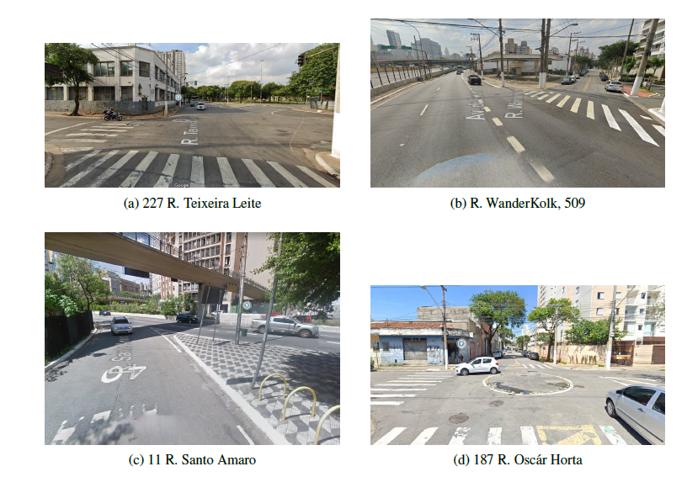
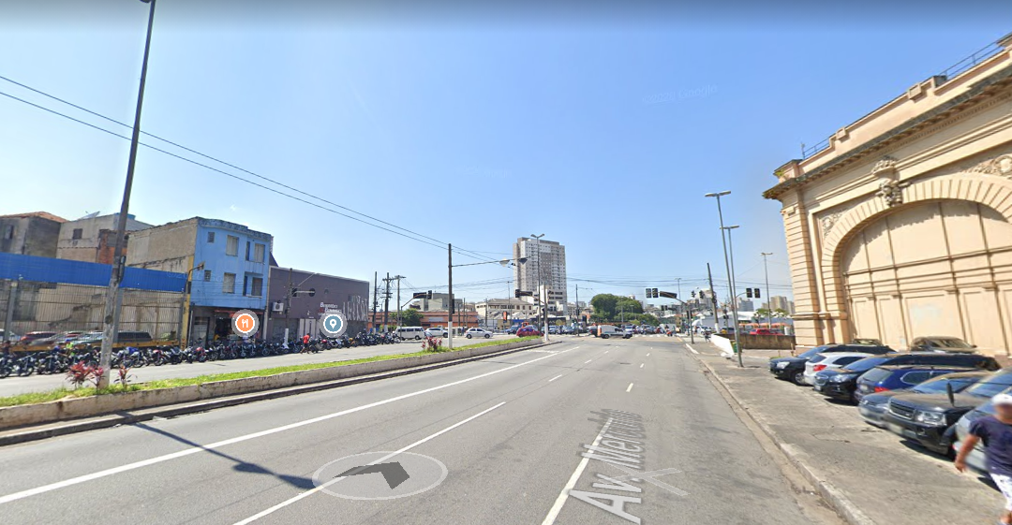
Perspectives
Scholarship renewal (let’s try it)
In situ analysis
When to send the early warning? What threshold?
857 Pluviometer region

Slide 9
Special Thanks
Luciana and Roberta: Twitter and floods discussion
Wilson Ceron: Tweets Data
Livia: Flood Data
Rogério Galante: Statistical analysis

Slide 10



THANKS
Do you have any questions?
vitor.yuichi@unesp.br
https://github.com/vitor-yuichi/Tweet_Pluviometer
UNESP- ICT

